Slide 1
CMP5327 C++ Programming for Games
Antonio-Mihai Dima
S18125008

Slide 2
Code profiling and optimization
Table 1 – Text Renderer Unoptimized
Table 2 – Text Renderer Optimized
Process | CPU | Percentage of total
Main | 1305 | 25.16%
GameLoop::Draw | 554 | 10.68%
TextRenderer::Draw | 124 | 2.39%
Tilemap::Draw | 53 | 1.02%
GameLoop::Update | 46 | 0.89%
BulletManager::Update | 24 | 0.46%
EnemyManager::Update | 10 | 0.19%
Process | CPU | Percentage of total
Main | 816 | 7.88%
GameLoop::Draw | 132 | 1.27%
Tilemap::Draw | 76 | 0.73%
GameLoop::Update | 28 | 0.27%
EnemyManager::Update | 11 | 0.11%
BulletManager::Update | 9 | 0.09%
Player::Update | 5 | 0.05%
Part 1. TextRenderer
The two tables above show the process memory usage improvement after the TextRenderer
script has been optimized.

Slide 3
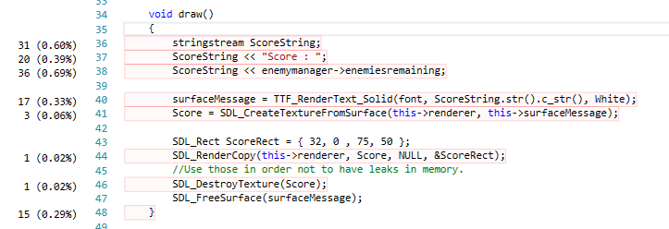
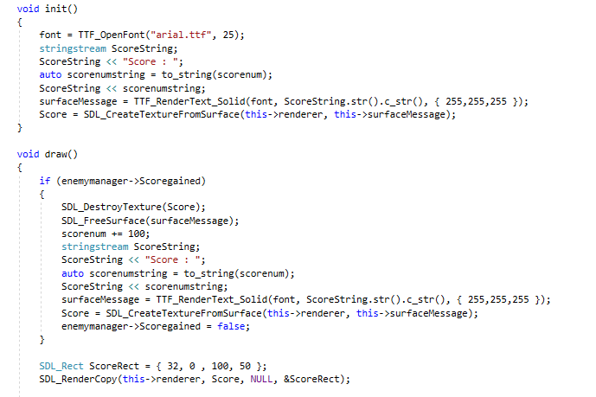
Figure 1 – Initial TextRenderer implementation
Figure 2 – TextRenderer code optimization
Initially a new stringstream was created every frame (if the game would run in 60 fps then 60 new stringstreams a second).
The benefit of the code optimization is that instead of creating a new stringstream every frame, have an if statement checking if the score needs to be changed and update the score only once. Also the previous texture and surface need to be deleted to avoid leaks of memory.

Slide 4
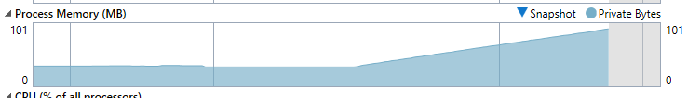
Figure 3 – GameOver Text memory leak
Part 2. GameOver
When the GameOver text was added, there was a memory leak in the code which
caused the process memory to skyrocket.

Slide 5
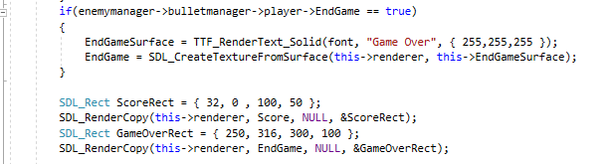
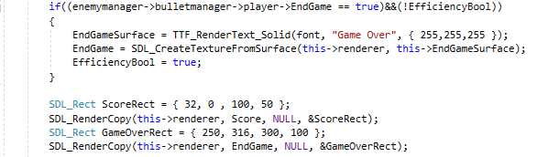
Figure 4 – GameOver script memory leak
Figure 5 – Memory leak fixed
Initially when the player lost all the health the EndGame boolean was switched to true and the
“Game Over” text appeared on screen. However every frame a new texture was created.
An EfficiencyBool boolean was added in order for the text to be rendered only once.

Slide 6
Table 3 – Code profiling before Object Pooling
Table 4 - Code profiling after Object Pooling
Process | CPU | Percentage of total
Main | 821 | 17.21%
GameLoop::Draw | 100 | 2.10%
GameLoop::Update | 41 | 0.86%
Tilemap::Draw | 38 | 0.80%
GameLoop::Update | 46 | 0.89%
BulletManager::Update | 26 | 0.55%
EnemyManager::Update | 13 | 0.27%
Process | CPU | Percentage of total
Main | 861 | 16.70%
GameLoop::Draw | 88 | 1.71%
Tilemap::Draw | 48 | 0.93%
GameLoop::Update | 30 | 0.58%
EnemyManager::Update | 22 | 0.43%
Player::Update | 5 | 0.10%
GameLoop::Init | 4 | 0.08%
Part 3. Shooting Object Pooling
The tables above show code profiling results based around shooting object pooling.

Slide 7
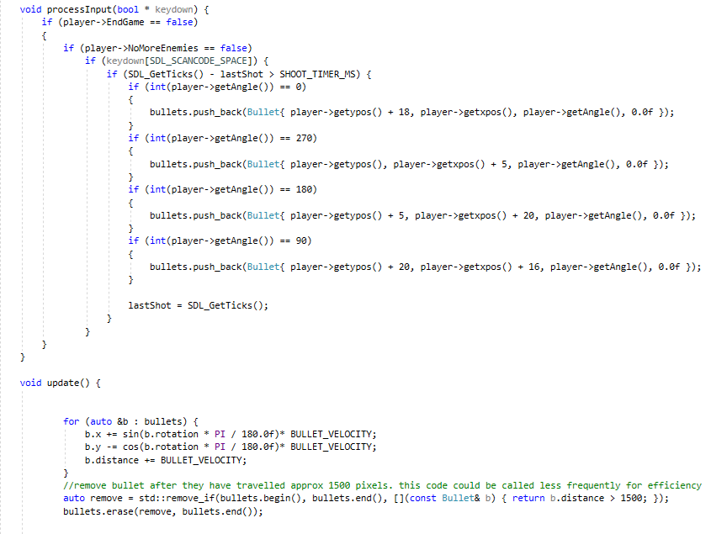
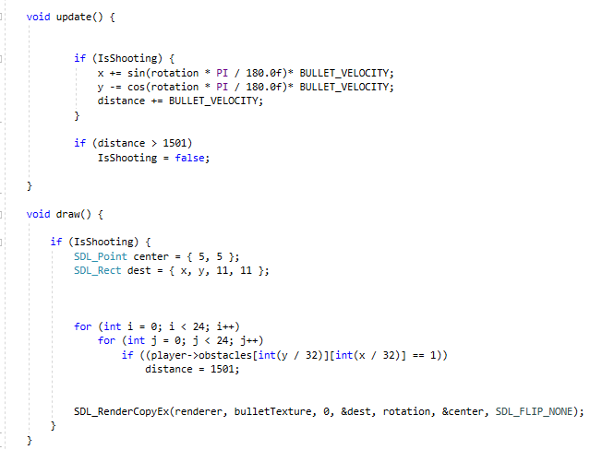
Figure 6 – Bullets managed into a Vector
Figure 7 – Object Pooling for bullets
Initially the bullets were managed inside a Vector. That was bad for memory because the software was always creating
and destroying bullet textures.
From internal play testing, based on the cooldown value between the bullets fired and the bullet travel speed it was concluded that only one bullet is used and rendered on screen each time. Therefore there was no need for using a vector or
an array for object pooling, when the player shoots the bullet moves to the player’s position and rotation and when the bullet is off screen it is not rendered anymore.

